Slide 1
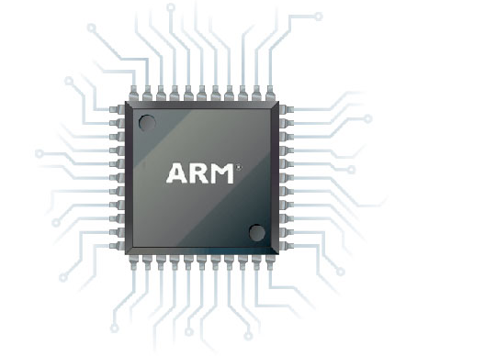



Slide 2
Nap-Time Media Systems
Benny Yan◘Cal Woodruf◘Thomas Betz

Slide 3
NAP Network Aware PLayer
Multi-Function Sound Machine
Share Files
Play MP3s
Record Audio
Send Memos
Intercom

Slide 4

Local Multicast network
Node finds nodes
description
NAP is a multi-function sound appliance that is network aware. This means nodes discover each other and share mp3s, audio memos and intercom connections.
NAP implements a local multicast network that any node can use to find other nodes on the network.

Slide 5
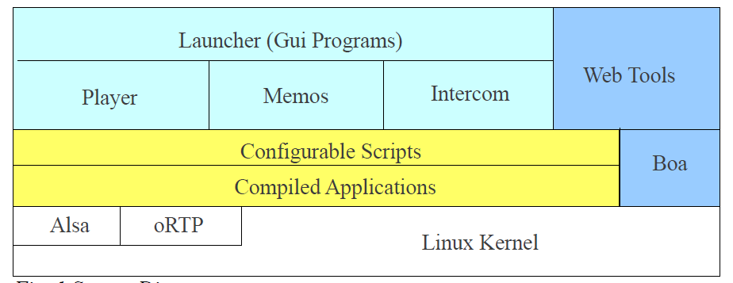
Nap node architecture

Slide 6
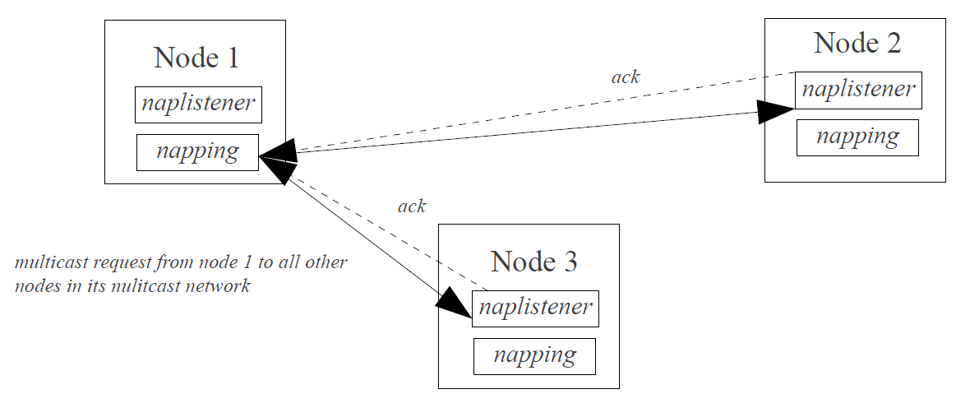
Multicast node discovery

Slide 7

madplay Control
Madplay is a command-line MPEG audio decoder and player based on MAD library.
Madplay can only be controlled from keyboard.
Modified Madplay source code so that madplay gets its control command from a named pipe.
Any other process has a way to pause, stop, resume, forward, back, increase/reduce volume and quit .

Slide 8
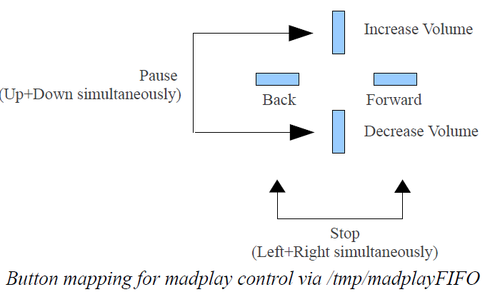
Button Interface

Slide 9
button interface
Programmed hardware button to write to the named pipe to control madplay operation
Pressing up/down button would increase/reduce volume
Pressing left/right button would back/forward play
Pressing left and right buttons simultaneously would pause
Pressing left and right buttons simultaneously once more would resume
Pressing up and down buttons simultaneously would quit.

Slide 10
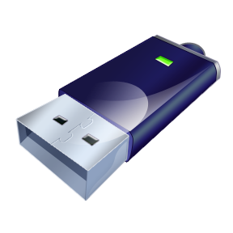
USB flash drive auto mount
Compiled kernel so that USB flash drive of any file system(fat16, fat32, ext2, ext3, ext4, etc.) can be recognized.
to auto mount, two available standard options: autofs and udev rule.
limited space, so we wrote our own program to scan partition table.
auto mount when usb flash drive is being inserted into USB slave port.
auto unmount when usb flash drive is being removed.

Slide 11
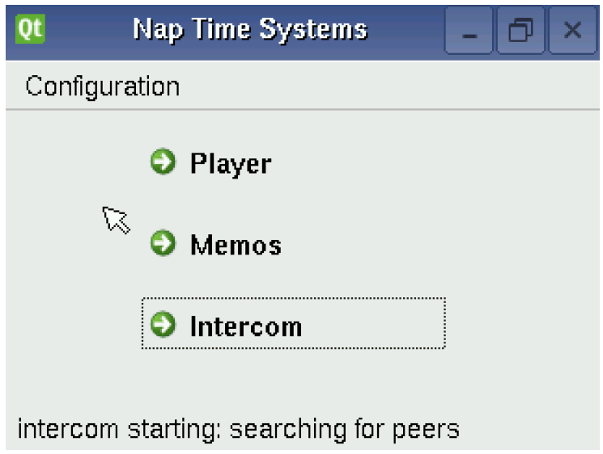
QT GUI -- launcHer

Slide 12
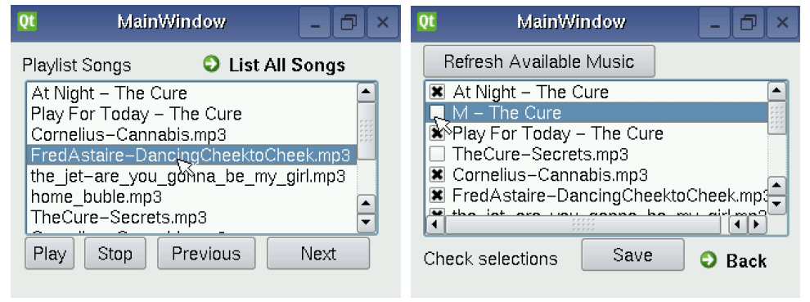
mp3 player gui

Slide 13
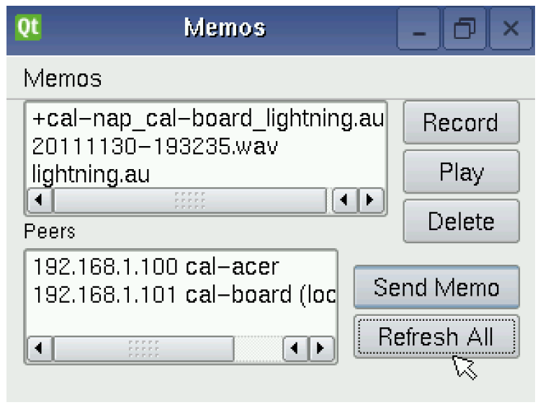
Audio memo gui

Slide 14
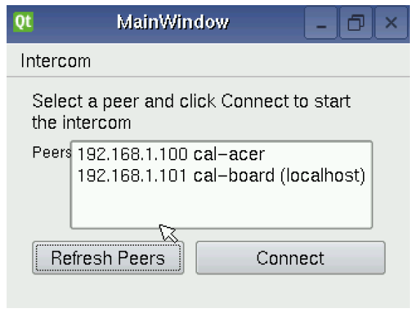
Intercom Gui

Slide 15

Demo Time

